Slide 1

Lecture 2
Planning Phase
Ethical Hacking
Diploma in CSF
Year 3 (2021/22), Semester 1
Notes:
Left-hand Bar – Replace FSP by your module code and X by the lecture number.
Replace Lecture Title
Replace < Module Name >
Replace Year and Semester if necessary

Slide 2
Learning Outcomes
At the end of the lecture, the learners will be able to:
Conduct contract review and identify information needed for planning;
Construct a document structure for the Scope and Rules of Engagement Document;
Construct a document structure for a Penetration Test Plan;
Discuss the legal matters related to Pen-Testing; and
Review Penetration Testing Report Template.

Slide 3
Contents
Securing a Pen-Test Project
Planning Phase and Purpose of Planning
Main Planning Activities
Contract Review
Review Scope Document
Review Rules of Engagement Document
Create Penetration Test Plan
Examine Legal Issues
Review Penetration Report Template

Slide 4
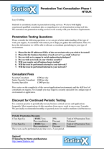
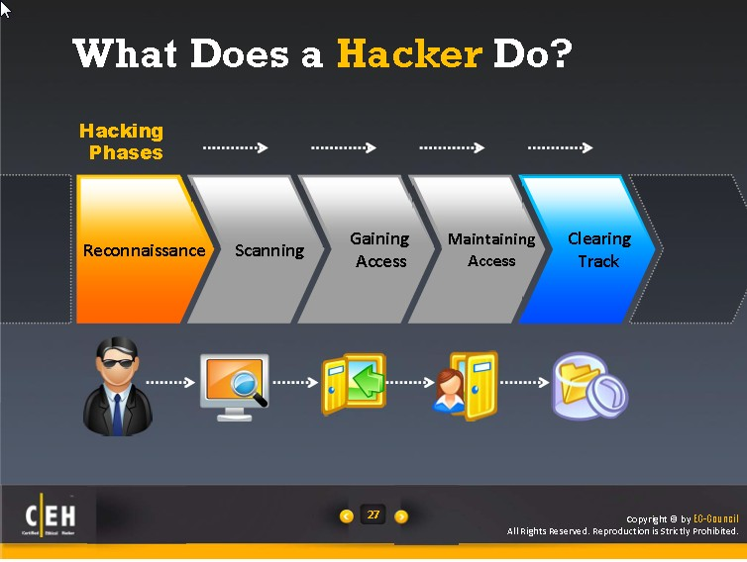
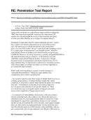
Recap: Pen-Test Process Model
Planning
Reconnaissance
Scanning
Exploit Systems
Reporting

Slide 5
Planning Phase

Slide 6

Purpose of Planning
Have a good plan, the project is ½ way to completion.
In practice, project plan differ from one another due to the differences in project requirements.
The main purpose of planning is to ensure project can be executed accordingly within the time and budget allocated.

Slide 7
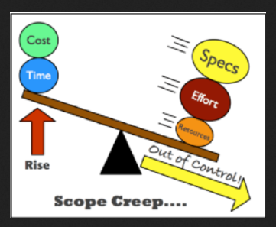
Importance of Planning
The main deliverables at the end of the Planning Phase is a Pen-Testing Project Plan, detailing the resources needed to carry out the test, milestone and schedule and a team of pen-testers who know the job well, and any other relevant information useful to getting the job done.
Failing in carrying out any of the activities properly may lead to many problems in the later phase. One major problem is scope creeping, this normally would lead to more time and funds needed.

Slide 8
Main Planning Activities
Team Forming and Project Planning
Contract Review
Review Scope Document
Review Rules of Engagement Document
Establish Pen-Test Plan
Examine Legal Issue

Slide 9
Team Forming & Project Planning

Slide 10
Team Forming & Project Planning
Team forming exercise usually starts when the pen-test team/company has been awarded the pen-test project or serve an Engagement Letter by the client.
The team may or may not comprises of a personnel that took part in submitting the proposal. In whichever the situation, the management of the pen-test company would appoint a chief pen-tester who will also play the role or project leader/manager to execute the project.
Team size normally depends on the scale, complexity and duration of the project. It also depends on the experience and capabilities of the individual pen-tester.
The selected pen-testers will be assigned with different roles and responsibilities to jointly tackle the project and to complete within the given time frame.

Slide 11
Project Planning commences when most information needed are in-hand. The team will plan and budget for the pen-test project which may need to include allowance, accommodation, airfare, and insurance for the individual pen-tester (for oversea project). The budget also needs to include extra resources needed, insurance for the project as well legal consultation.
The Pen-Test Leader will call for a meeting to review the contract. The purpose of this Contract Review session is to ensure everyone in the team knows what the project encompasses, the duration, the target organization, the location, the scope, the rules of engagement and all other information in the contract and proposal, exclude the tendered price.

Slide 12
Contract Review

Slide 13
Thinking Question 2.1
List as many ways as possible on how a pen-test company could secure a Pen-Test Contract.
Present your answers in the excel spreadsheet especially created for this activity in your class's channel for week 2.

Slide 14
Assumptions
For the purpose of our module, we assumed that the contract has been signed between the pen-test company and a client that wanted their networks and systems to be pen-tested.
It was secured by an experienced sale director through a public tender exercise.
The contract was passed on to a team of Pen-Testers to review and the CEO has asked for a project plan to be drafted by the next working day.

Slide 15
Finding Out what Exactly Involved
This task is usually fall into the hand of a Chief Pen-Tester or a Manager that task to in-charge of the project.
Typically, the contract would include:
• Explicit exclusions (eg. systems that are out of scope)
• Technical and operational constraints
• Roles and responsibilities for all parties concerned
• Specific legal and regulatory requirements
• Timings and checkpoints
• A problem escalation process
• Reporting and presentation style
• Post-test corrective action strategy and action plan development
• Pricing and terms of business
Example of Pen-Test Contract/Agreement available on the Internet:
https://vdocuments.site/truesec-pentest-agreement-v2pdf.html

Slide 16
What may have missed out....
At the end of contract review exercise, the team would have also identified the expertise and tools needed to complete the project. Provision must be made to acquire the resources needed to compliment the team.
The team would also have the basic information about the target organization. However, these information may not be adequate for the project and provision must be made to acquire necessary company's Intel from ONIST or other third companies.

Slide 17
Review Scope Document

Slide 18
Scope Document
This document established what are to be tested and the information is crucial to all concerned.
Depending on the experience and skills of the official that seal the contract, the information captured in the contract may not be adequate to form a complete Scope Document.
In most practical situation, the Chief Pen-Tester needs to contact the person in-charge to clarify the scope and zoom in as far as one can to capture more details on the scope.
One need to be-careful not to enlarge the scope and lead to over run of budget allocated.
It is good to know the time and budget allocated for this project before carrying out this exercise.
Chief Pen-Tester needs to propose a budget, subject to the management’s approval.

Slide 19
Contents of Scope Document
At the minimum, the following information need to be captured:
Contact Person and Contact Information
Details on what are to be included in the test
Details on what are excluded in the test
Any general or useful information
The pen-test team details can be omitted if it is created for contract sealing purpose.

Slide 20
Signing-off of Scope Document
This document needs to be signed-off by authorized personnel from both parties and witnessed by independent personnel from legal firm.
This has to be legally bind to prevent any disputes down the road.
The document can be revised to include or to exclude any items mutually agreed by both parties. These additional pages must be in printed form and signed off by authorized personnel from both parties.

Slide 21
Knowledge, Skill, Activity
Review
Rules of Engagement Document

Slide 22
Rules of Engagement Document
This document captured how the test is to be carried out.
Again the information captured in the contract may not be adequate to form a complete Rules of Engagement Document.
Same as in the case of Scope Document, the Chief Pen-Tester needs to contact the person in-charge to clarify the rules and obtain more rules as far as possible.
This set of document is important to the pen-testers because it guided them on what are the things they can do and what are the things they cannot do during the pen-test exercise.

Slide 23
Contents of Rules of Engagement Document
At the minimum, the following information need to be captured:
Contact Person and Contact Information
General Information which include Start Date, End Date, Time Available for Testing
Details on how the test is to be carried out?
Any other useful information but not consider as rule of engagement.
The pen-test team details can be omitted if it is created for contract sealing purpose.

Slide 24
Signing-off of Rules of Engagement Document
This document also needs to be signed-off by authorized personnel from both parties and witnessed by independent personnel from legal firm.
The document also has to be legally bind to prevent any disputes down the road.
The document can be revised to include or to exclude any other item mutually agreed by both parties. These additional pages must also be in printed form and signed off by authorized personnel from both parties.

Slide 25
Thinking Question 2.2
For a private arrangement exercise. Suggest and discuss one benefit of having clear and concise Scope Document and RoE Document before a contract is drafted and put forth to the client.
Present your answers in the excel spreadsheet especially created for this activity in your class's channel for week 2.

Slide 26
Thinking Question 2.3
Suggest and explain how you handle scoop creeping or changes to rules of engagement during a pen-test project?
Present your answers in the excel spreadsheet especially created for this activity in your class's channel for week 2.

Slide 27
Create Penetration Test Plan

Slide 28
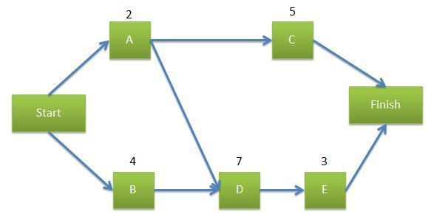
What is a Penetration Test Plan?
This is like a Project Management Plan. The purpose is to detail how the whole project is to be carried out in the given timeline and within the proposed budget.
Construct a project network diagram.
It is meant for all the Project Team members and the Management of the company. This project test plan is not meant for the client.

Slide 29
Signing-off of Penetration Testing Plan
This document needs to be signed-off by every member of the team and approve by the management of the company.
The document can be revised with the approval of the management when needed.

Slide 30
Knowledge
Legal Matters

Slide 31
Legal Matters
Without written permission from the client and if the client still want to go ahead with the Penetration Test, the whole exercise may ended up in court when things went wrong.
In practise, the penetration Company needs to engage the service of legal firm to check for any legal implications and advise the client accordingly.
Legal matters is beyond the scope of this module. Students are advise to adhere closely to the sign-off Cybersecurity Act Awareness and Ethical declaration form as well as “Code of Ethic” (signed during Year 1) provided by the school.
Refer to the following URL for more readings:
https://www.securitymagazine.com/articles/88489-penetration-testing-by-letter-of-the-law
https://www.techrepublic.com/article/dont-let-a-penetration-test-land-you-in-legal-hot-water/

Slide 32
Knowledge
Review Penetration Report Template

Slide 33
Preparing a Penetration-Testing Report
Depending on the job at hand and its scope, the report can be different from one another.
In general, they needs to directly address the approach used, the findings, the threats to the business operations and risks to the organization.
Evidences related to the findings must also be provided in the report.
It must also provides recommendations to these findings.
Students need to develop the skills of deciding what goes in there and what need not included depending on the project at hand.
There are many examples and templates available on the Internet.
Few of these good samples could be found at
http://darrylmacleod.wordpress.com/
https://www.offensive-security.com/reports/sample-penetration-testing-report.pdf
https://www.sans.org/reading-room/whitepapers/bestprac/writing-penetration-testing-report-33343

Slide 34
Thinking Question 2.4
Imagine the pen-test project is for a Financial Institution in Hong Kong. Suggest what are to be included in a Project Plan to be submitted to your management for approval?
Present your answers in the excel spreadsheet especially created for this activity in your class's channel for week 2.

Slide 35
Summary

Slide 36
Summary
We have covered the following in this lecture:
Planning Phase and Purpose of Planning
Main Planning Activities
Team Forming
Contract Review
Review Scope Document
Review Rules of Engagement Document
Create Penetration Test Plan
Examine Legal Issues
Review Penetration Report Template

Slide 37
Q&A

Slide 38
End

